Slide 1


Slide 2
Content Analysis

Slide 3





Team Members
Anant Bairagi
Lifu (Mario) Ma
Priyanka Murugan
Sripriya Srinivasan
Trishal Jadhav

Slide 4









Agenda
Introduction
Data source
Challenges
Hypothesis 1
Hypothesis 2
Hypothesis 3
Conclusion

Slide 5
Introduction
Problem Statement
Building visualizations to showcase how content produced for Netflix changes across regions and progresses over time
Users and Objective
Our visualizations can help content producers understand their target audience and preferences in what they consume
They can also help Netflix fine-tune its recommendations based on trends in content consumption across different consumer segments

Slide 6
Data Sources
The Netflix data used for the project was obtained from Kaggle:
Netflix Movies and TV Shows
The data for regions used for mapping countries was obtained from Kaggle:
Country Mapping - ISO, Continent, Region

Slide 7
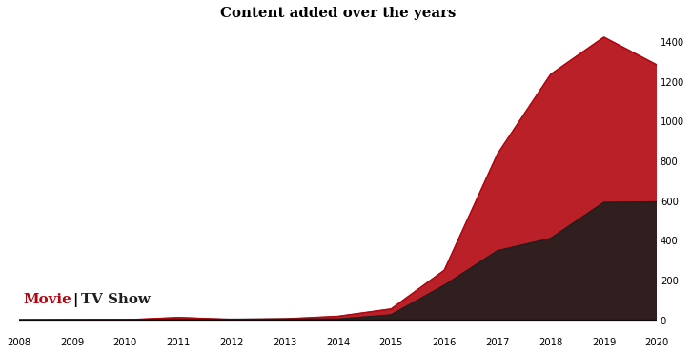
Hypothesis 1 - More content is added during the Holiday period in the Americas and Europe
Key insights -
Rapid growth in content only from 2015 especially for Movies over TV shows
Content additions slump during COVID-19 pandemic

Slide 8
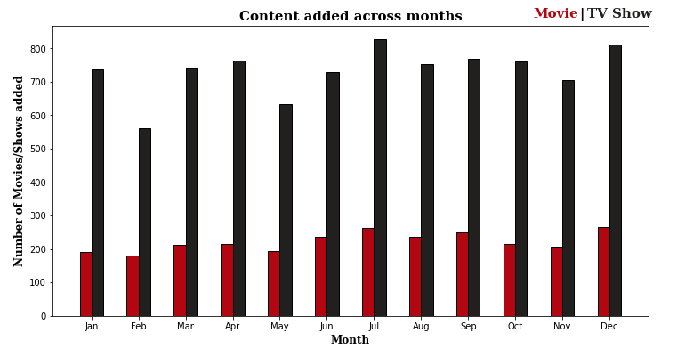
Hypothesis 1 - More content is added during the Holiday period in the Americas and Europe
Key insights -
July and December which is vacation period observe the highest number of content added
Users motivated to add more content during this period

Slide 9
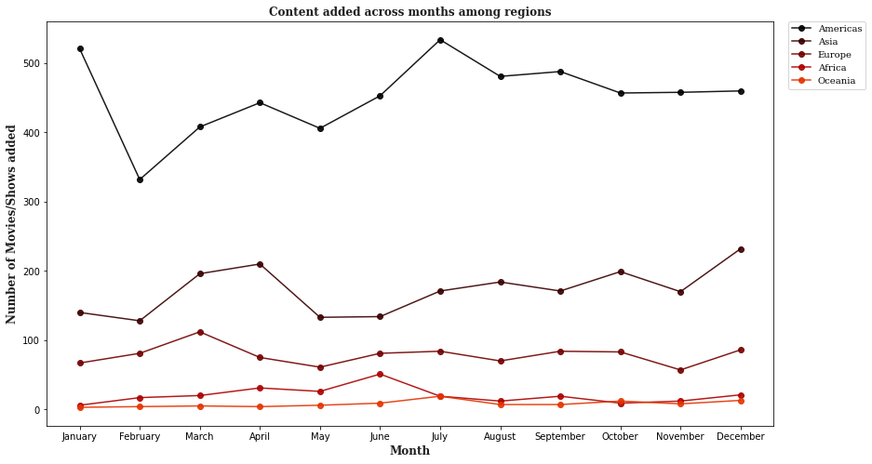
Hypothesis 1 - More content is added during the Holiday period in the Americas and Europe
Key insights -
Americas and Asia observe the highest content additions among all regions especially in July and December
No strong evidence to support hypothesis for Europe

Slide 10
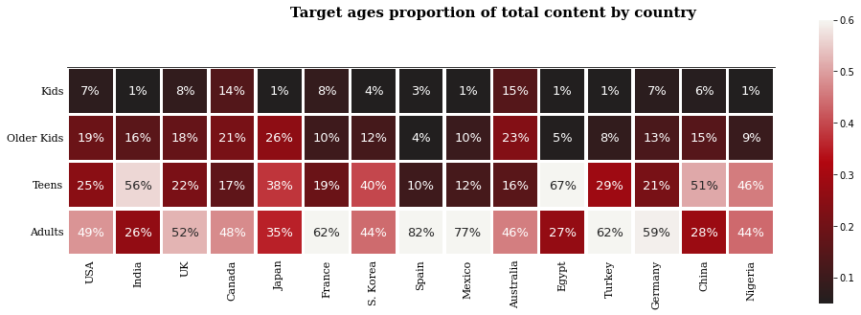
Hypothesis 2 - More Mature content in the west?
The answer may be YES!!
Key insights -
For India, only 26% of content is for adults.
For Spain, 82% of content is for adults.

Slide 11
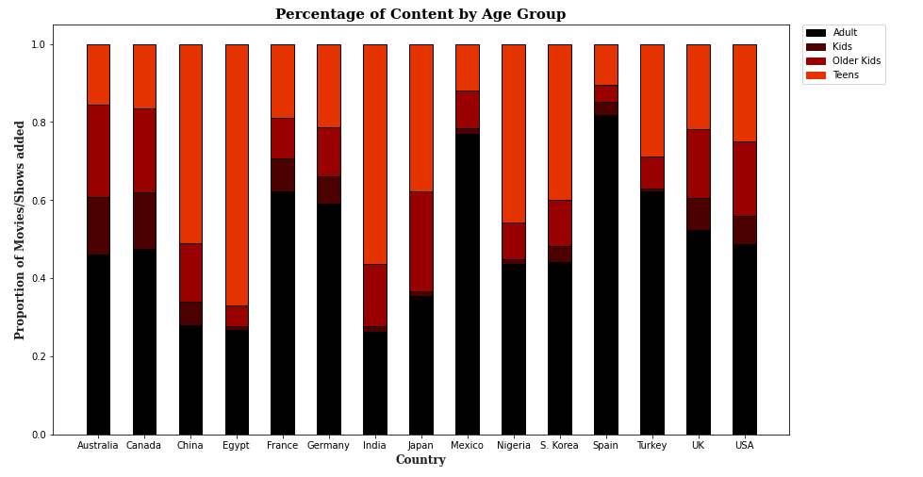
Hypothesis 2 - More Mature content in the west?
To be more specific:

Slide 12
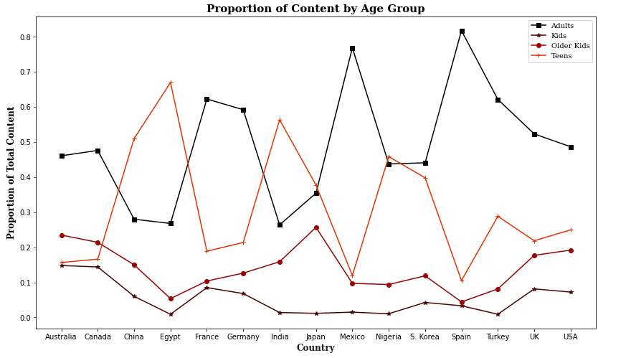
Hypothesis 2 - More Mature content in the west?
Key insights -
The target ages significantly differ between Western and Eastern cultures
Netflix should pay attention to this difference

Slide 13
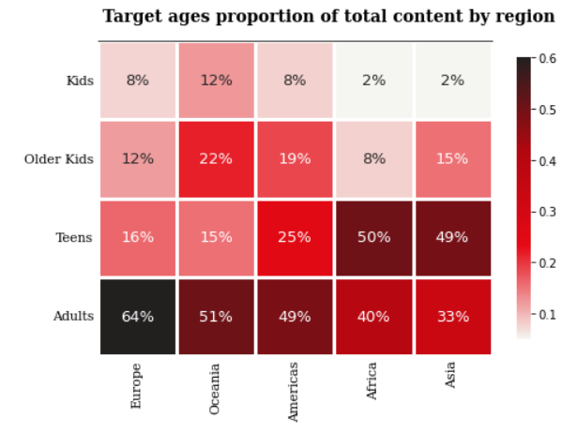
Hypothesis 2 - More Mature content in the west?
Key insights -
Europe has 64% of adult content, which is the highest among all.
Asia and Africa has highest proportion of Teen content
Notes:
Try filtering on year

Slide 14
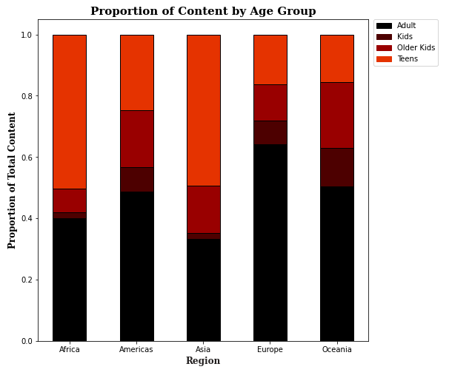
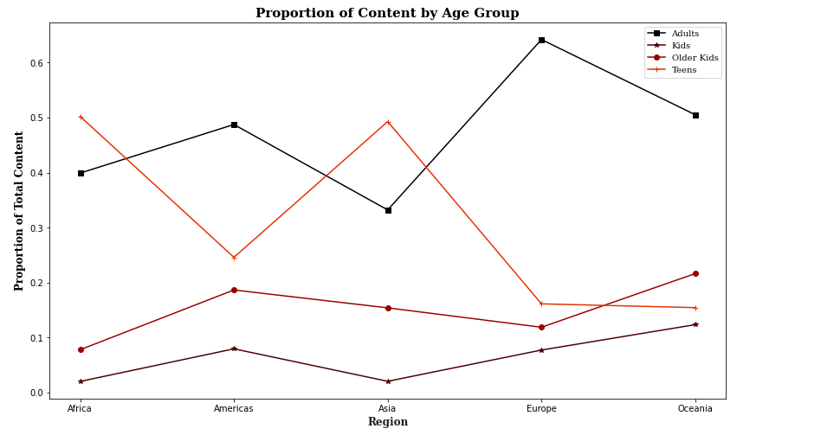
Hypothesis 2 - More Mature content in the west?
Key insights -
Europe has the highest and Asia has the least proportion of mature content

Slide 15
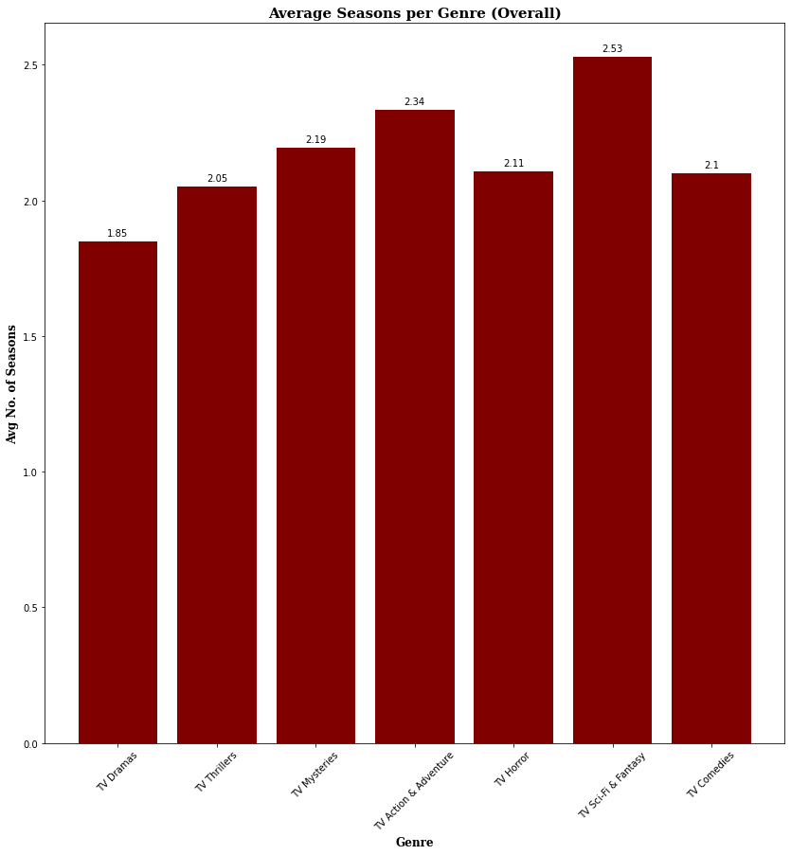
Hypothesis 3 - Among all genres for TV Shows, comedies have the highest number of seasons
2.53
2.34
2.19
2.11
2.1
2.05
1.85
Key insights -
SciFi & Fantasy TV series have the highest average number of seasons at 2.53
Drama genre has the lowest average number of seasons at just 1.85

Slide 16
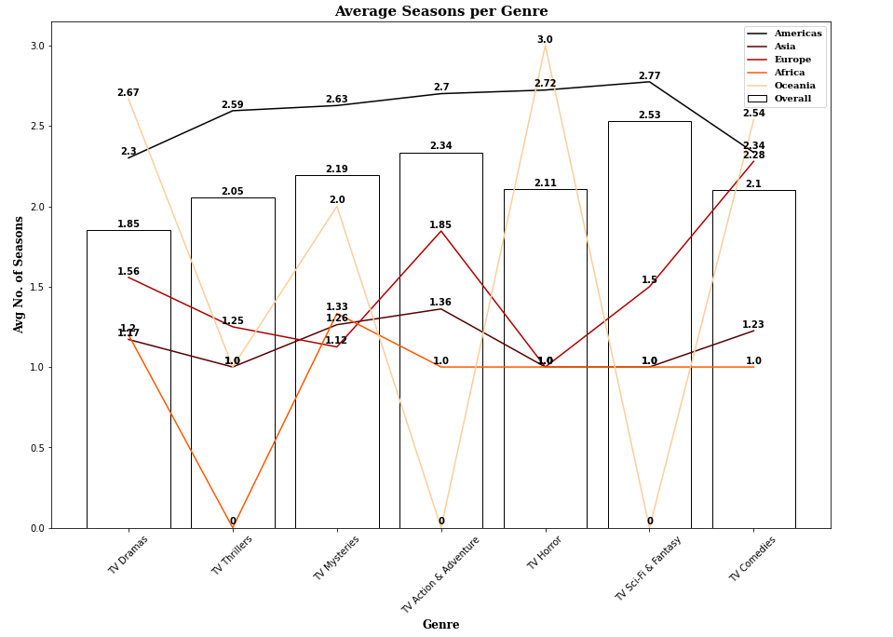
Hypothesis 3 - Among all genres for TV Shows, comedies have the highest number of seasons
Key insights -
Hypothesis is indeed true when sub sectioned by region. For Europe Comedies do have highest number of average seasons at 2.28

Slide 17
Challenges
Data Cleaning
Making sure the data obtained can be directly translated into visualizations by checking data types, cleaning text fields and merging required data
Hypothesis Formulation
Finding problems we can solve using the data that can help our end user make better decisions
Refining Visualizations
Iteratively tweaking our visualizations so that they the convey the message from the data in the most clear way possible

Slide 18
Conclusion
01
When to create ?
Holidays are the best time to add new content, especially in Asia and Americas region
02
The west is more accepting of mature content, whereas the eastern regions like Asia seem more conservative towards it.
What to create ?
03
Sci-fi & Fantasy have highest number of seasons, whereas Dramas have the least. It is also necessary to view this by region to better understand target audience.
How much to create ?

